Slide 1
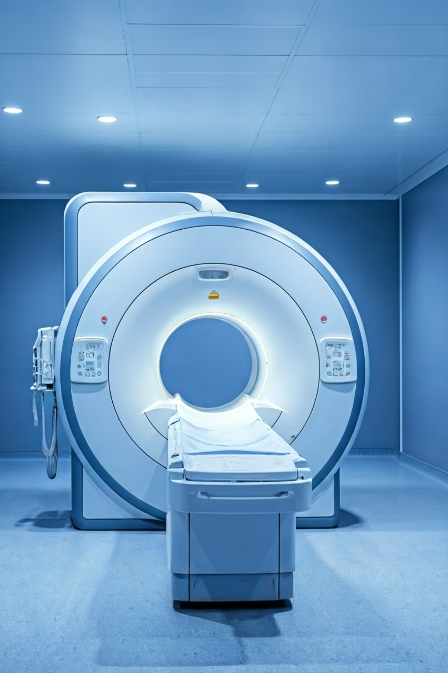

MRI Scan: Explained for Beginners
What is an MRI Scan?
An MRI Scan is a medical test that uses strong magnets and radio waves to take clear and detailed pictures of the inside of your body.
It helps doctors see organs, bones, tissues, and blood vessels without any surgery.
by Ram N Java

Slide 2

What does MRI mean?
Magnetic – Uses a powerful magnet
Resonance – Uses radio waves
Imaging – Creates pictures

Slide 3

Why is an MRI Scan done?
Doctors use an MRI scan to:
Find the cause of pain or swelling
Check for injuries
Look for tumors or infections
Monitor brain, spine, joints, heart, liver, and more

Slide 4

How is an MRI Scan done?
Step 1
You lie down on a flat bed.
Step 2
The bed slides into a large tunnel-like machine.
Step 3
The machine uses magnets and radio waves to take pictures.
Step 4
It may take 30 to 60 minutes.
Step 5
You need to stay very still so the pictures are clear.

Slide 5

Is it painful?
No, it does not hurt at all.
You may hear loud sounds like knocking or buzzing — this is normal.
You may be given earplugs or headphones.

Slide 6

Do you get an injection?
Sometimes, a contrast dye is given through a small injection to see things more clearly.
It is safe for most people.

Slide 7
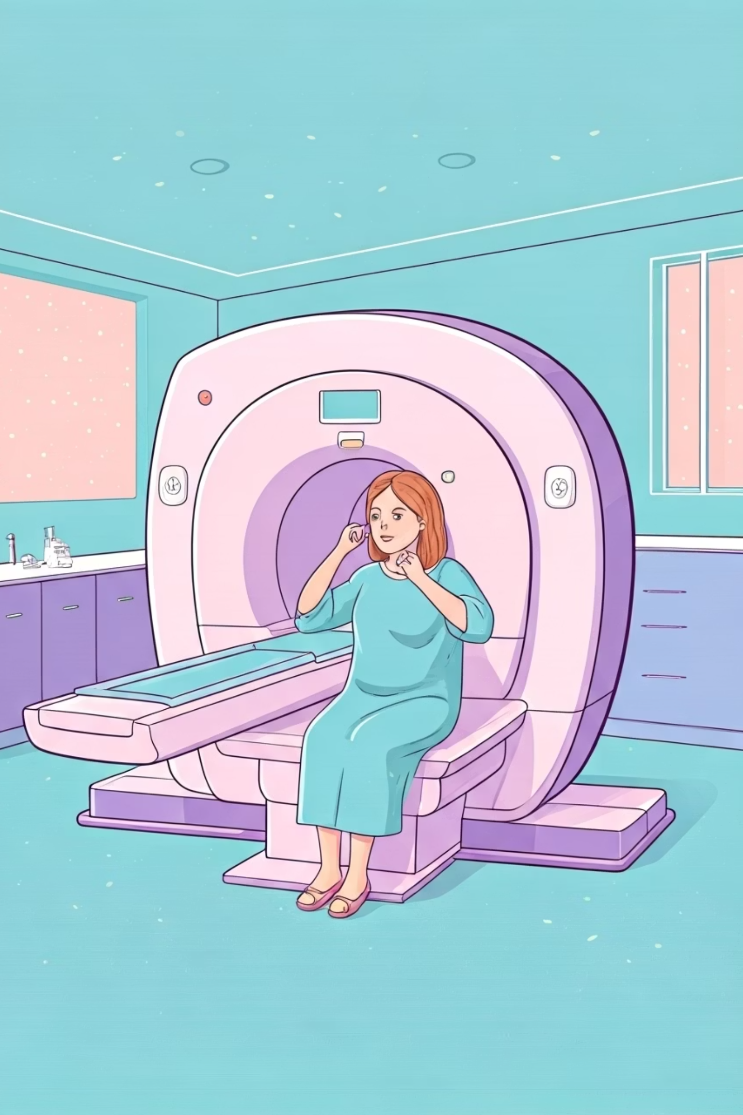



Do you need to prepare?
Eating & Drinking
You may need to avoid eating or drinking for a few hours.
Metal Items
Remove metal items like jewelry, belt, or coins.
Tell the doctor if you:
Have metal implants, pacemaker, or clips
Are pregnant
Have kidney problems

Slide 8

Is it safe?
Yes, MRI is very safe.
It does not use radiation like X-rays or CT scans.
It is safe even for children and repeated use, unless you have certain metal implants.

Slide 9

How do you get results?
Step 1
1
A doctor (radiologist) checks the images.
2
Step 2
You get the report within a few hours or a day.
Step 3
3
Your doctor will explain the result and what to do next.

